Slide 1
Cinema-Scale Movie Recom. System
Our Final Group Project

Slide 2
Table of contents
01
About the Project
What we have build?
Thr Frontend

Slide 3
Table of contents
01
02
About the Project
Database
What we have build?
Thr Frontend
Database Structure and seeding

Slide 4
Table of contents
01
02
03
About the Project
Database
Auth and admin
What we have build?
Thr Frontend
Database Structure and seeding
We will talk about roles implemented

Slide 5
Table of contents
01
02
03
04
About the Project
Database
Auth and admin
What we have build?
Thr Frontend
Database Structure and seeding
We will talk about roles implemented
Architecture
The project architecture and structure

Slide 6
Table of contents
01
02
03
04
05
About the Project
Database
Auth and admin
What we have build?
Thr Frontend
Database Structure and seeding
We will talk about roles implemented
Architecture
ML Pipeline
The project architecture and structure
How we have build and trained the ML.

Slide 7
Table of contents
01
02
03
04
05
06
About the Project
Database
Auth and admin
What we have build?
Thr Frontend
Database Structure and seeding
We will talk about roles implemented
Architecture
ML Pipeline
Live Demo
The project architecture and structure
How we have build and trained the ML.
We will give a live demonstration of the website.

Slide 8
01
About Project
Overview and the frontend

Slide 9

What is Cinema-Scale
An interactive, full-stack movie browsing & recommendation platform
Content-based filtering using TF-IDF Vectorization & Cosine Similarity
Dynamically enriches movie metadata from TMDB API & Wikipedia CDN
Supports user authentication, reviews, watchlists, and admin controls
Processes 45,000+ movies from a comprehensive CSV dataset

Slide 10
The Tech Stack
Backend
A
Flask
SQL
Used Flask as backend framework
Used SQLite to store the data

Slide 11
The Tech Stack
Backend
Model
A
B
Flask
SQL
Python lib.
Used Flask as backend framework
Used SQLite to store the data
Used various python libs to train the model

Slide 12
The Tech Stack
Backend
Model
Frontend
A
B
C
Flask
SQL
Python lib.
Template
JS
Used Flask as backend framework
Used SQLite to store the data
Used various python libs to train the model
Used HTML, CSS
To make pages interactive

Slide 13
What I did?
HTML
Made all the templates and displayed data using Jinja.

Slide 14
What I did?
HTML
CSS
Made all the templates and displayed data using Jinja.
Provided beautiful UI and colors to the website and made it dynamic.

Slide 15
What I did?
HTML
CSS
JS
Made all the templates and displayed data using Jinja.
Provided beautiful UI and colors to the website and made it dynamic.
Added JavaScript to give life to the website.

Slide 16
02
Database
The Database Structure and Seeding

Slide 17
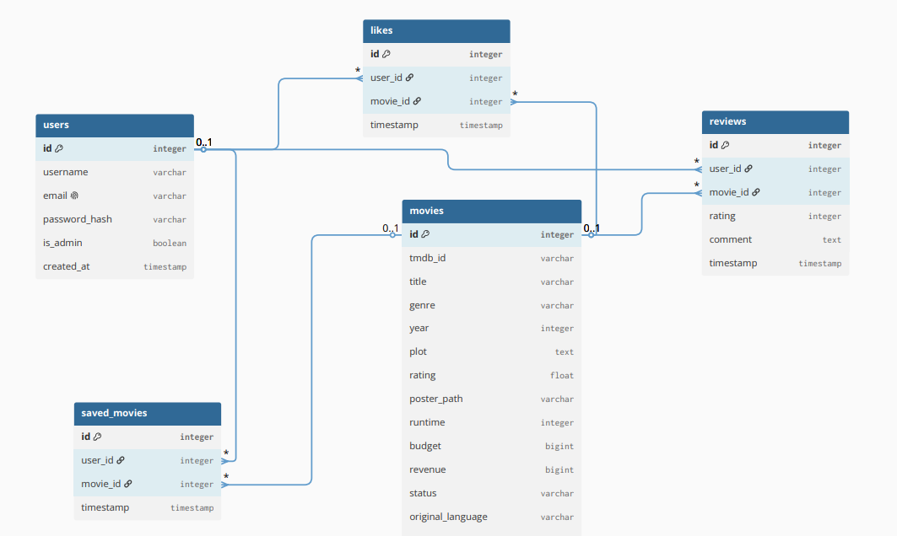
ER Diagram

Slide 18
Database
Users
user.py
Defines the user stucture

Slide 19
Database
Users
Movies
user.py
Store all the data from the movies.csv
Defines the user stucture
movie.py

Slide 20
Database
Users
Movies
Likes
user.py
Store all the data from the movies.csv
like.py
Defines the user stucture
Stores the likes of the users
movie.py

Slide 21
Database
Users
Movies
Likes
Reviews
user.py
Store all the data from the movies.csv
like.py
Stores the reviews of the users
Defines the user stucture
Stores the likes of the users
movie.py
review.py

Slide 22
Database
Users
Movies
Likes
Reviews
s.m
user.py
Store all the data from the movies.csv
like.py
Stores the reviews of the users
Sm.py
Defines the user stucture
Stores the likes of the users
Stores the saved movies from the user.
movie.py
review.py

Slide 23
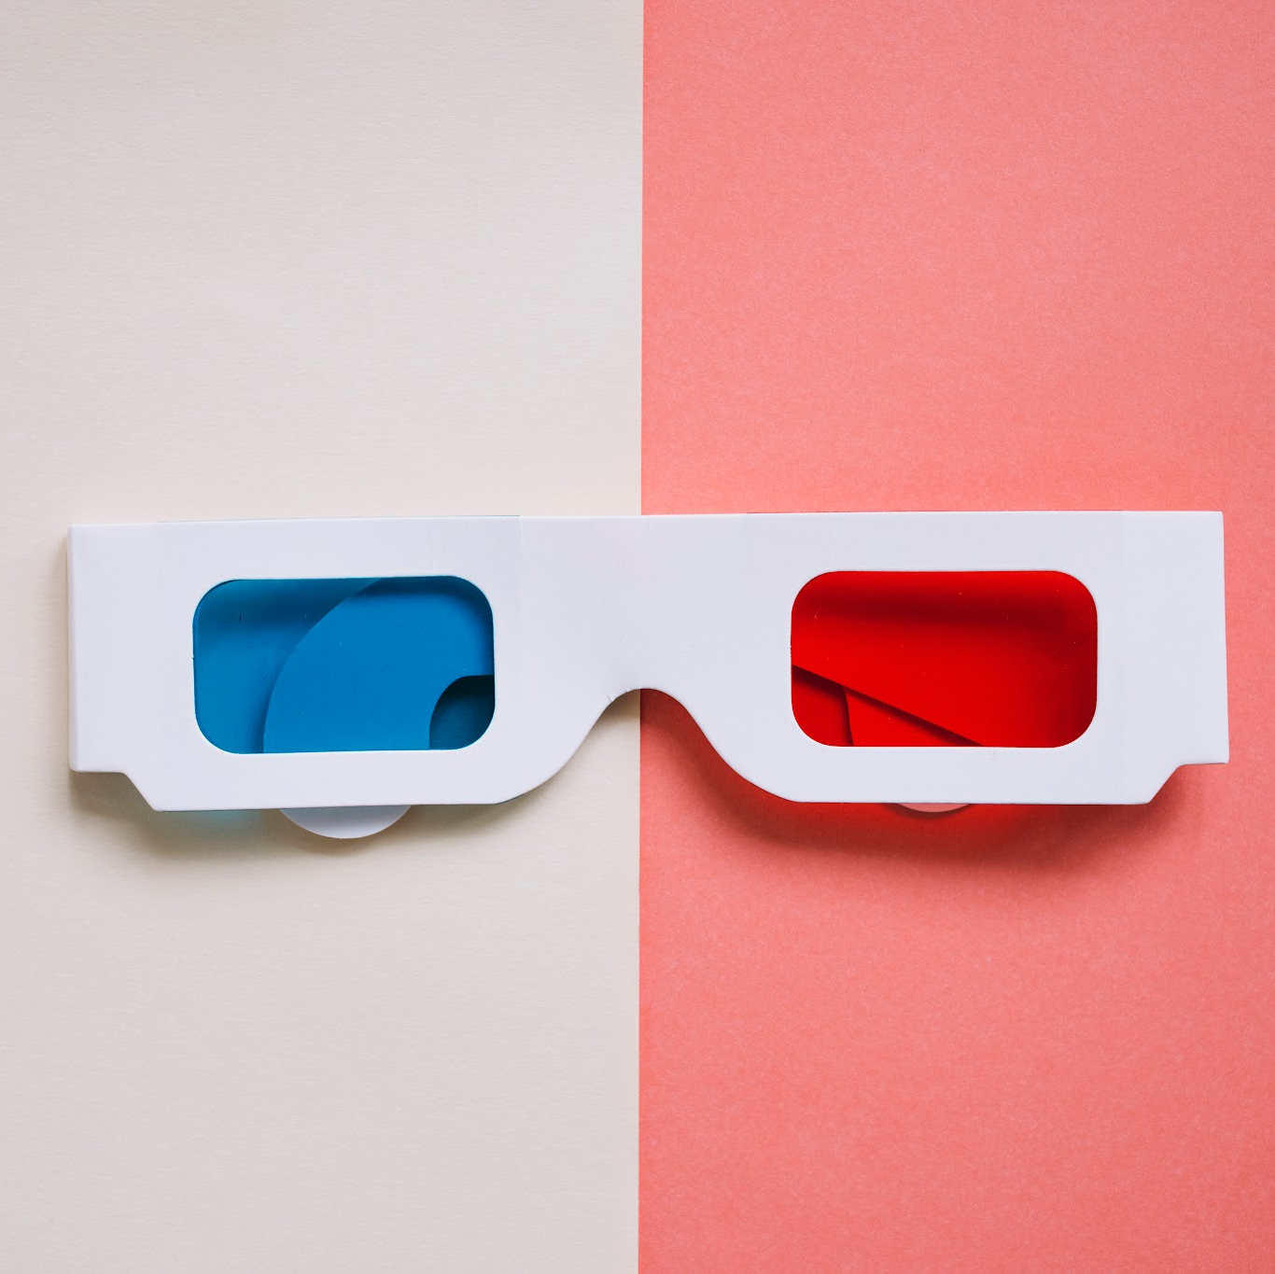
Database Seeding
Source dataset: movies.csv with 45,000+ movie records
Chunk-based seeding: loads data in batches to prevent memory overflow
On-demand metadata enrichment via TMDB API (budget, runtime, revenue)
Wikipedia Media API fallback when TMDB is rate-limited or unavailable
Poster paths cached in database to avoid repeated API calls
populate_posters.py script for batch pre-populating poster URLs

Slide 24
03
Auth & Admin
About the roles and the authentication

Slide 25
Authentication System
Unified Gateway
One single route manages registration and user logins.

Slide 26
Authentication System
Unified Gateway
Secure Hashing
One single route manages registration and user logins.
Password details are encrypted safely before storing.

Slide 27
Authentication System
Unified Gateway
Secure Hashing
One single route manages registration and user logins.
Password details are encrypted safely before storing.
Session Tracking
Client cookies preserve login state across pages.

Slide 28
Authentication System
Unified Gateway
Secure Hashing
One single route manages registration and user logins.
Password details are encrypted safely before storing.
Session Tracking
Dynamic Navigation
Client cookies preserve login state across pages.
Page headers adapt automatically to login status.

Slide 29
User Roles & Access Control
Two-Tier System
Accounts are split into regular and administrative users.

Slide 30
User Roles & Access Control
Two-Tier System
Safe Default
Accounts are split into regular and administrative users.
New signups automatically receive regular access rights.

Slide 31
User Roles & Access Control
Two-Tier System
Safe Default
Accounts are split into regular and administrative users.
New signups automatically receive regular access rights.
Route Guards
Secure checks block unauthorized users from admin pages.

Slide 32
User Roles & Access Control
Two-Tier System
Safe Default
Accounts are split into regular and administrative users.
New signups automatically receive regular access rights.
Route Guards
Full Moderation
Secure checks block unauthorized users from admin pages.
Administrators can edit listings and delete user accounts.

Slide 33
04
Architecture
We will talk about the project architecture.

Slide 34
System Flow & API Integration
Client-Server Architecture
Web clients communicate with Flask blueprint controllers using asynchronous HTTP requests for seamless, uninterrupted page loading.
Controllers verify session-based user authentication states before retrieving requested views or processing interaction blueprints.

Slide 35
System Flow & API Integration
Client-Server Architecture
API & Scraper Integration
Web clients communicate with Flask blueprint controllers using asynchronous HTTP requests for seamless, uninterrupted page loading.
Controllers verify session-based user authentication states before retrieving requested views or processing interaction blueprints.
A background metadata scraper queries TMDB and Wikipedia CDN APIs on-the-fly when movie listings lack essential poster paths.
Retrieved metadata and remote image links are cached locally to minimize API queries and boost load speeds.

Slide 36
In-Memory ML Pipeline
Model Eager Training
The model vectorizes movie attributes and builds similarity matrices once during server startup to prevent request-time bottlenecks.
Precomputed matrices reside in server memory, enabling rapid recommendation checks when users browse film pages.

Slide 37
In-Memory ML Pipeline
Model Eager Training
Similarity & Typo Matching
The model vectorizes movie attributes and builds similarity matrices once during server startup to prevent request-time bottlenecks.
Precomputed matrices reside in server memory, enabling rapid recommendation checks when users browse film pages.
Cosine similarity compares high-dimensional TF-IDF vectors representing movie genres, keywords, taglines, cast, and directors.
Python's difflib library performs fuzzy matching on user search inputs to handle typos without crashing.

Slide 38
Database & Cache Design
Relational Schema
A structured SQLite or PostgreSQL database tracks relationships across five tables: users, movies, reviews, likes, and saves.
Cascading foreign keys and unique constraints maintain referential integrity and prevent duplicate user interactions.

Slide 39
Database & Cache Design
Relational Schema
Database Caching Strategy
A structured SQLite or PostgreSQL database tracks relationships across five tables: users, movies, reviews, likes, and saves.
Cascading foreign keys and unique constraints maintain referential integrity and prevent duplicate user interactions.
The movies table stores local copies of raw dataset listings and scraped external API metadata.
Caching poster links and movie details locally reduces external requests, ensuring consistent and rapid user experience.

Slide 40
05
ML Pipeline
Now we will talk about the ML-Pipeline

Slide 41
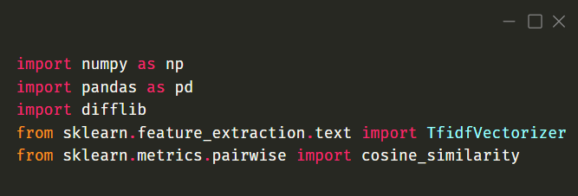
Step 1: Importing Libraries & Dependencies
numpy & pandas: Foundation libraries for array and dataframe manipulations.
difflib: Standard Python library containing tools to compare sequences (fuzzy string matching).
TfidfVectorizer: Converts collection of raw documents to a matrix of TF-IDF features.
cosine_similarity: Calculates the angular similarity between movie vectors.

Slide 42
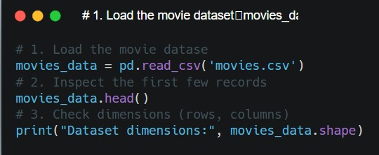
Step 2: Data Loading & Shape Inspection
pd.read_csv: Loads the source file 'movies.csv' into a structured pandas DataFrame.
movies_data.head(): Inspects the top 5 records to understand available columns and formats.
movies_data.shape: Confirms the scale of the dataset (row count and column count).

Slide 43
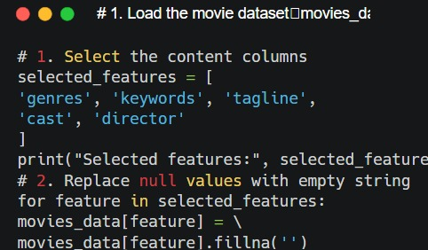
Step 3: Feature Selection & Handling Nulls
Feature Selection: We narrow down the dataset columns to only those capturing a movie's creative identity (genres, keywords, tagline, cast, director).
fillna(''): Missing entries in the selected columns are replaced with an empty string.
Crucial data cleaning: Leaving Null (NaN) values in text records causes vectorizer operations to fail with float errors.

Slide 44
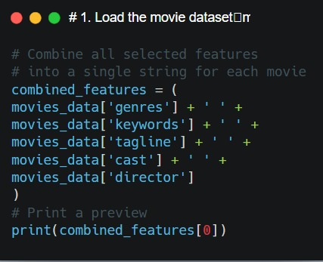
Step 4: Feature Combination
String Concatenation: Merges the cleaned string features with single space separation.
Unified Profile: The output is a single combined string of descriptors representing the movie's artistic fingerprint.
Acts as input to the TF-IDF Vectorizer to extract vocabulary weightings.

Slide 45
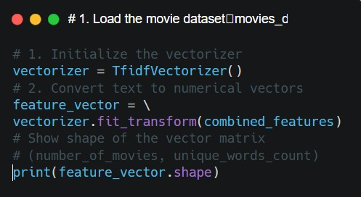
Step 5: TF-IDF Vectorization
TfidfVectorizer: Instantiates the transformer that tokenizes and normalizes terms.
fit_transform: Fits vectorizer to vocabulary and converts raw strings to sparse matrix representation.
TF (Term Frequency): Gives weight to terms that appear often inside a movie's metadata.
IDF (Inverse Document Frequency): Reduces weight for words common across all movies (e.g. 'the', 'movie') and raises importance of unique terms (e.g. 'cyberpunk').

Slide 46
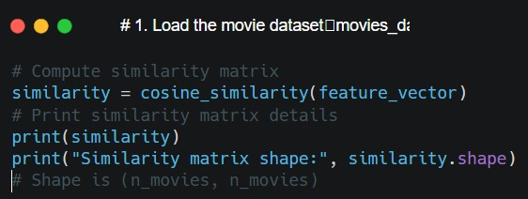
Step 6: Precomputing Cosine Similarity Matrix
cosine_similarity: Measures the angle between movie vectors in high-dimensional space.
Score Range: Value from 0.0 (perpendicular, completely dissimilar) to 1.0 (collinear, identical).
N x N Matrix: Generates an indexable array mapping all movies against all movies.
Allows O(1) retrieval: Precalculating it at startup avoids having to compute it dynamically during request times.

Slide 47
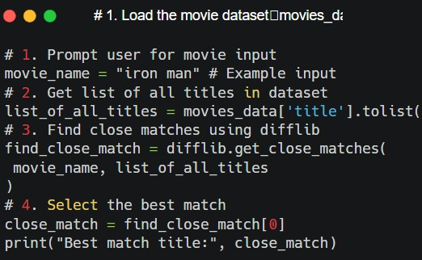
Step 7: Fuzzy Matching User Search Queries
Fuzzy Comparison: Users often supply typos or incomplete names (e.g. 'Ironman' or 'Avatar 1').
list_of_all_titles: Extracts all official titles as a reference list.
difflib.get_close_matches: Performs sequence similarity ratio matches and returns sorted matches.
Top Match: Extracts index [0] from the match list as our target movie for recommendations.

Slide 48
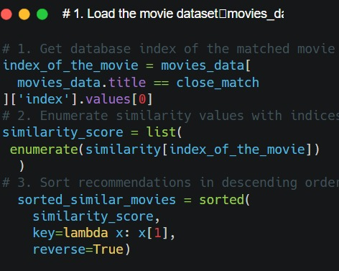
Step 8: Recommendation Retrieval & Sorting
Index Lookup: Obtains the specific index location of our resolved movie inside the DataFrame.
Score Extraction: Retrieves the corresponding similarity row `similarity[index]`.
enumerate(): Pairs each similarity score with its corresponding target movie index: `(movie_index, similarity_score)`.
sorted(): Sorts the list descendingly using score values to rank similar movies first.

Slide 49
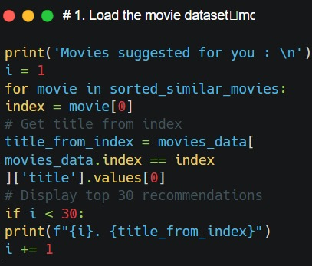
Step 9: Outputting Recommendations
Title Translation: Looks up the text title for each index in the sorted suggestions list.
Self Filtering: Ignores the query movie itself (which will always have a similarity score of 1.0 and rank first).
Cutoff: Displays the top 30 matched results as final outputs for the user's recommendations feed.

Slide 50

Now Live Demonstration

Slide 51
Thanks!
Do you have any questions?
Please keep this slide for attribution

Slide 52
Alternative resources
Here’s an assortment of alternative resources whose style fits that of this template:
Vectors
Flat design cinema festival facebook cover
Hand drawn cinema festival instagram posts
Cinema festival instagram posts
Flat design cinema festival facebook cover

